Slide 1
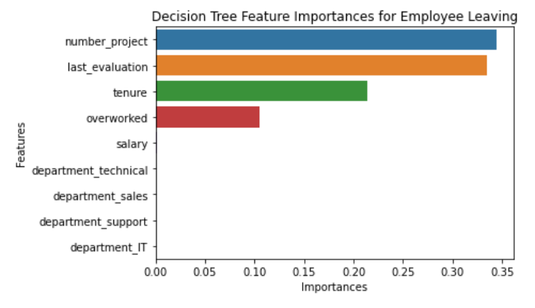
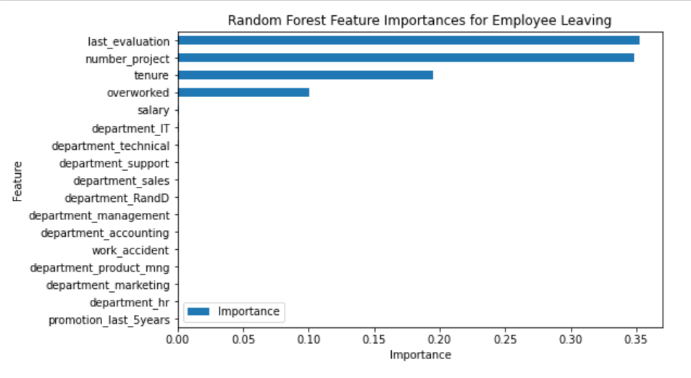
Salifort Motors
Employee Retention Project
Salifort Motors wants to improve their employee retention rate, so they want to know what factors affecting employees to leave the company.
The target or dependent variable is categorical (0: stay, 1:leave), and the team built logistic regression and tree-based machine learning model.
The random forest model slightly outperforms the decision tree model (based on auc_score metric).
This model help predict whether an employee will leave and identify which factors are most important.
These insights can help HR to make decisions in improving employee retention.
From decision tree model, the most important variables are number_project, last_evaluation, tenure, and overworked.
From random forest model, the most important variables are last_evaluation, number_project, tenure, and overworked.
These variables are most helpful in predicting the target variable.
Limit the number of projects that employees work on concurrently
Consider promoting employees who have been with the company for at least four years, and also conduct investigation about why four-year tenured employees are so dissatisfied.
Either reward employees for working longer hours, or don't require them to do so.
If employees aren't familiar with the company's overtime pay policies, inform them about this. If the expectations around workload and time off aren't explicit, make them clear.
Hold company-wide and within-team discussions to understand and address the company work culture, across the board and in specific contexts.
High evaluation scores should not be reserved for employees who work 200+ hours per month. Consider a proportionate scale for rewarding employees who contribute more/put in more effort.

